Slide 1
Overview of Kotlin Multiplatform

Slide 2
Contents
Introduction to Kotlin Multiplatform
Creating a Kotlin Multiplatform app
Understanding the shared module
Running the app

Slide 3
1. Introduction to Kotlin Multiplatform
Setting the scene
Using Kotlin Multiplatform for Android / iOS
Using Kotlin Multiplatform for shared libraries

Slide 4
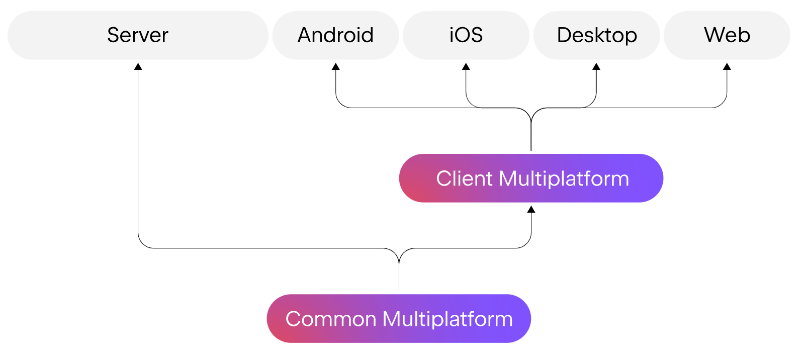
Setting the Scene
Kotlin originally emerged as a "better Java"
Nice new features that Java didn’t yet have
E.g., operator functions, data classes, etc.
Kotlin has evolved into a "multi-platform" technology
The ability to create code that runs on multiple platforms
Write once, run anywhere

Slide 5
Using Kotlin Multiplatform for Android / iOS
You can use Kotlin Multiplatform to create mobile apps that share code between Android and iOS
You can share common application logic
Accessing resources, networking, algorithms, etc.
You can also share UIs
Via Compose Multiplatform, a Kotlin-based declarative UI framework from JetBrains

Slide 6
Using Kotlin Multiplatform for Shared Libraries
You can also use Kotlin Multiplatform to create multiplatform libraries
Contains common code
A multiplatform library can also specify hooks where platform-specific APIs can be plugged in
The library specifies expected declarations
Platform-specific implementations provide actual declarations to fulfil the requirements

Slide 7
2. Creating a Kotlin Multiplatform App
Setting up Android Studio
Setting up Xcode
Creating a simple cross-platform app
Reviewing the project structure

Slide 8
Setting up Android Studio
We'll be using Android Studio
The official IDE for Android app development
Install via https://developer.android.com/studio
Once you've installed Android Studio, you'll also need to install the Kotlin Multiplatform Mobile plugin
Select File | Settings | Plugins
Search Marketplace for Kotlin Multiplatform Mobile, and install

Slide 9
Setting up Xcode
To write iOS-specific code and run an iOS app on a real or simulated device, you need Xcode
Go to https://www.apple.com/store and search for Xcode
Note: to run Xcode, you need a Mac with macOS

Slide 10
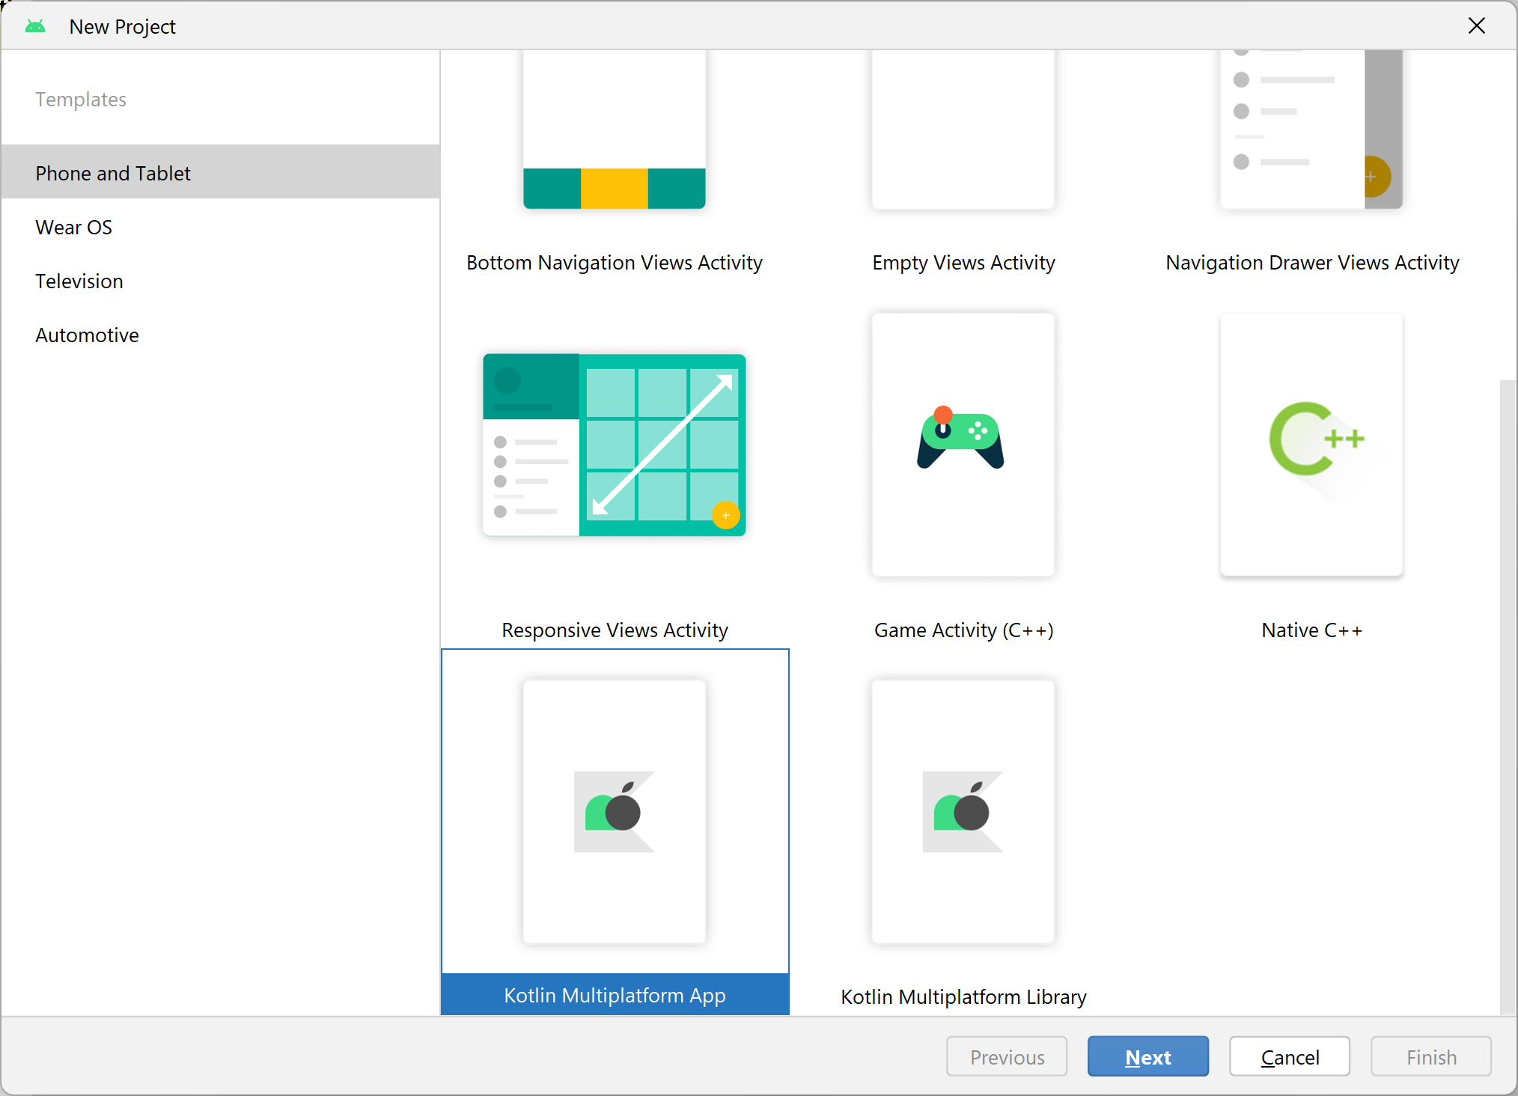
Creating a Simple Cross-Platform App (1 of 3)
In Android Studio, select File | New | New Project
Select Kotlin Multiplatform App, then click Next

Slide 11
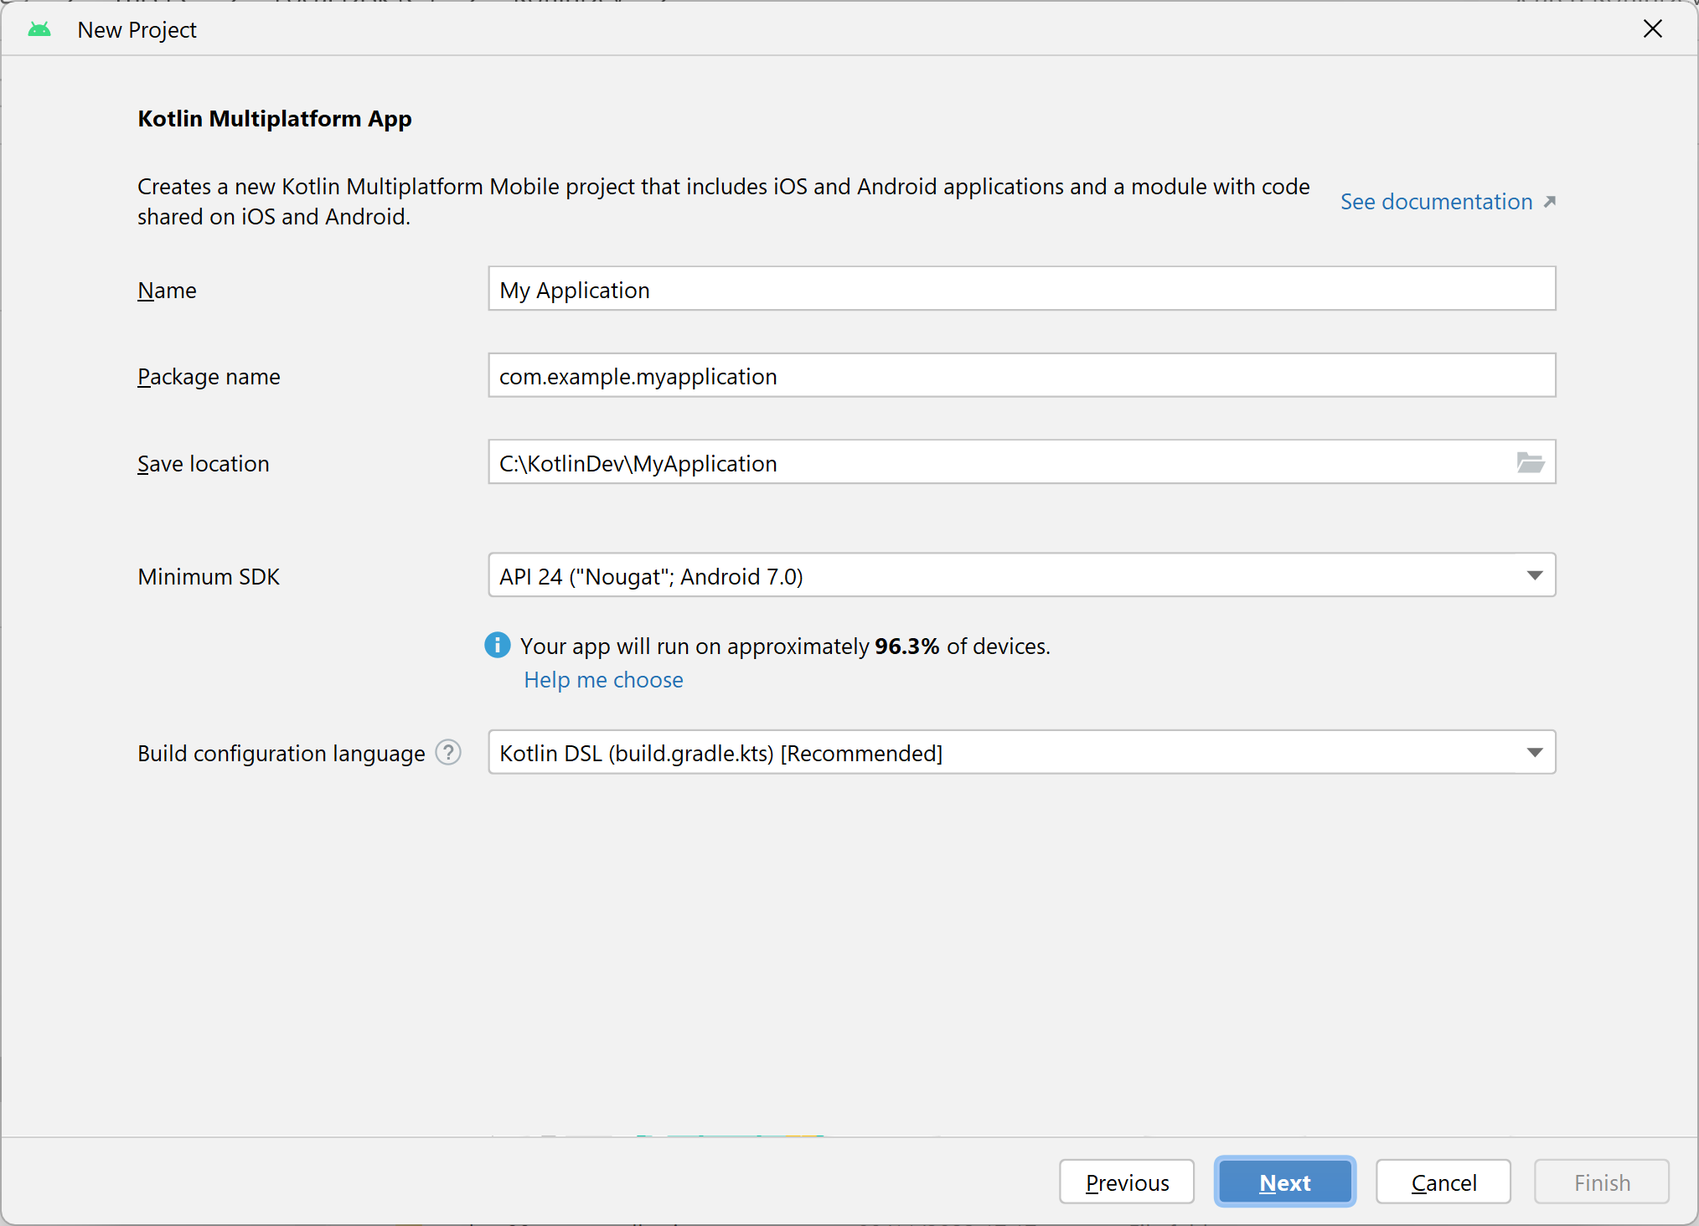
Creating a Simple Cross-Platform App (2 of 3)
Enter suitable details, then click Next

Slide 12
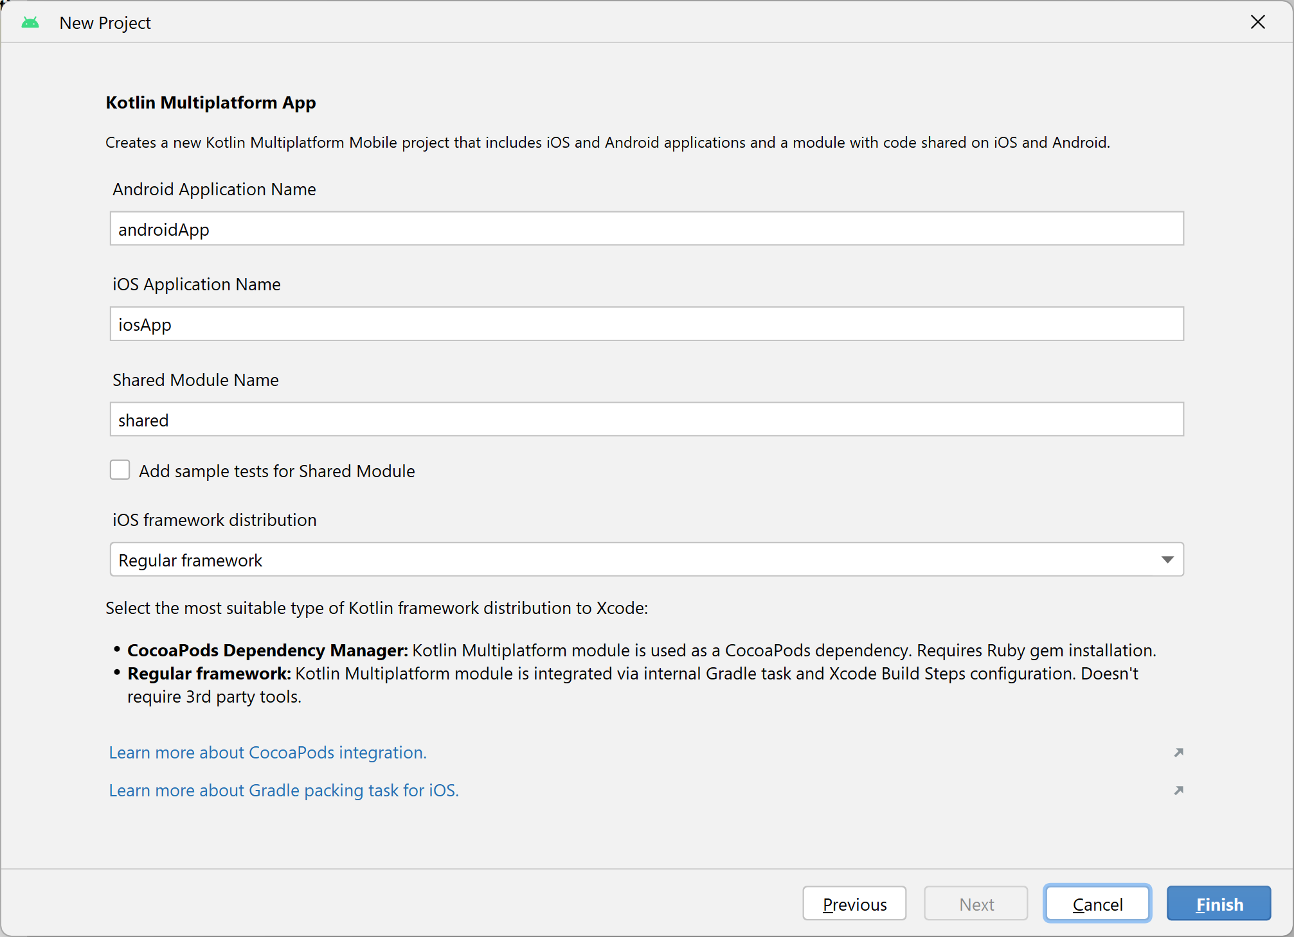
Creating a Simple Cross-Platform App (3 of 3)
Choose these details, then click Finish
This app will be runnable on Android
This app will be runnable on iOS
This module contains shared code

Slide 13
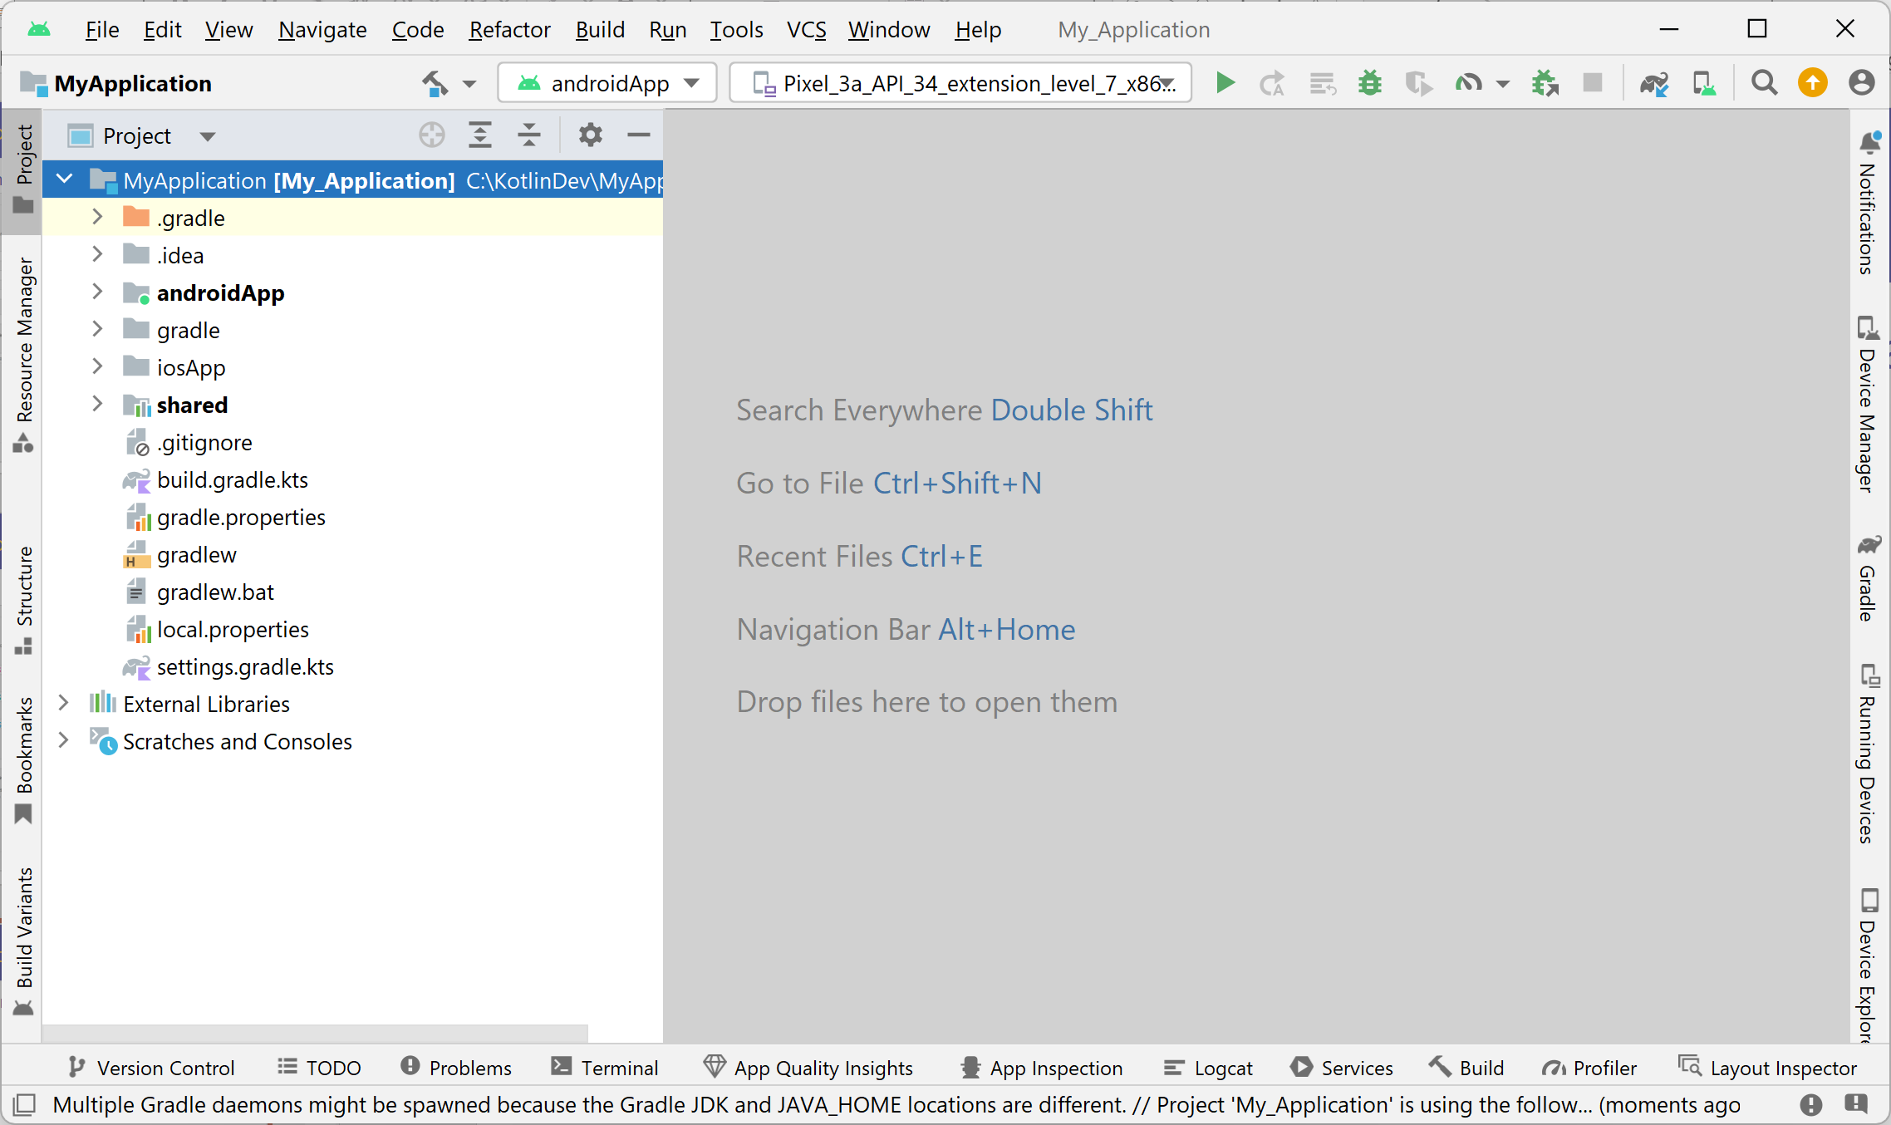
Reviewing the Project Structure
Android Studio creates the following project structure:
androidApp is a Kotlin module that builds into an Android app.
Depends on the shared module as a regular Android library.
iosApp is an Xcode project that builds into an iOS app.
Depends on the shared module as an iOS framework.
shared is a Kotlin module that contains the logic common
for both Android and iOS apps.

Slide 14
3. Understanding the Shared Module
The shared module structure
How the shared module is built
Writing common declarations
Providing platform-specific implementations

Slide 15
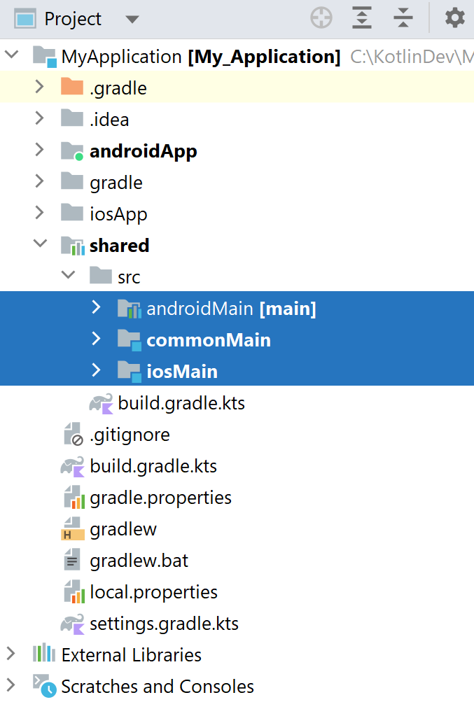
The Shared Module Structure
The shared module contains 3 source sets:
commonMain
Contains common Kotlin source code, platform-neutral
androidMain
Contains Kotlin/JVM source code for Android platform
iosMain
Contains Kotlin/Native source code for iOS platform

Slide 16
How the Shared Module is Built
This is how the shared module is built:
When the shared module is build into an Android library, it is treated as Kotlin/JVM
When the shared module is build into an iOS library, it is treated as Kotlin/Native

Slide 17
Writing Common Declarations
Take a look in the commonMain source set
Contains common Kotlin code
Cannot contain Java-specifics or iOS-specifics
There are 2 Kotlin source files
package com.example.myapplication
class Greeting {
private val platform: Platform = getPlatform()
fun greet(): String {
return "Hello, ${platform.name}!"
}
}
Greeting.kt
package com.example.myapplication
interface Platform {
val name: String
}
expect fun getPlatform(): Platform
Platform.kt

Slide 18
Providing Platform-Specific Implementations
Take a look in the androidMain source set
Fulfils expectations in an Android-specific manner
Now take a look in the iosMain source set
Fulfils expectations in an iOS-specific manner
package com.example.myapplication
class AndroidPlatform : Platform {
override val name: String = "Android ${android.os.Build.VERSION.SDK_INT}"
}
actual fun getPlatform(): Platform = AndroidPlatform()
Platform.android.kt
package com.example.myapplication
import platform.UIKit.UIDevice
class IOSPlatform: Platform {
override val name: String = UIDevice.currentDevice.systemName() + " " +
UIDevice.currentDevice.systemVersion
}
actual fun getPlatform(): Platform = IOSPlatform()
Platform.ios.kt

Slide 19
4. Running the App
Managing devices
Running an app on a device
Understanding the applications themselves

Slide 20
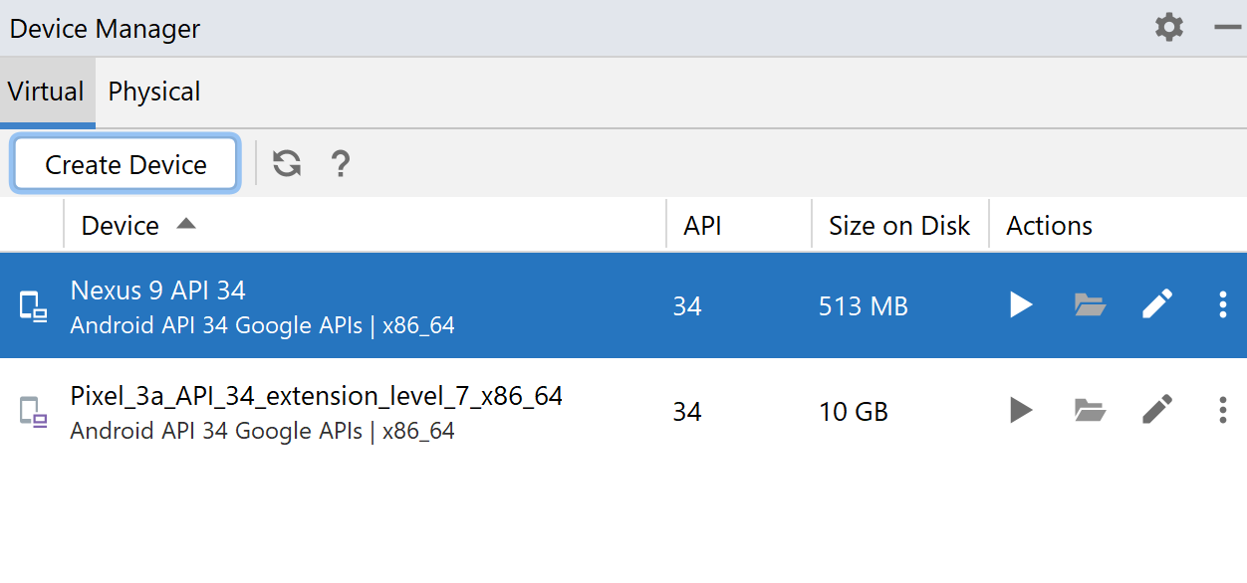
Managing Devices
Android Studio lets you manage devices, so you can run your Android / iOS apps in a simulator or real device
To manage devices:
Click View | Tool Windows | Device Manager
Create / manage devices as appropriate

Slide 21
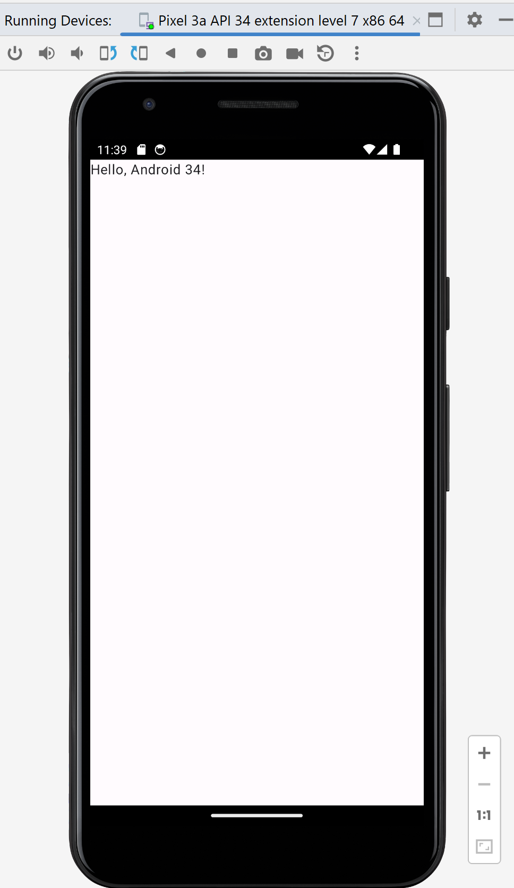
Running an App on a Device
In the Android Studio toolbar:
Select an app (androidApp or iosApp)
Choose a device
Click
The app should run in the specified device

Slide 22
Understanding the Apps Themselves
If you're curious, you can take a look at the Android or iOS source code
For the Android app:
See the androidApp module
In particular, see MainActivity.kt
For the iOS app:
See the iosApp module
In particular, see ContentView.swift

Slide 23
Any Questions?

